Slide 1
COLLEGE PROJECT · ACADEMIC YEAR
University Timetable
Room Minimizer
An intelligent system for optimizing classroom and laboratory utilization across a university campus.
Student/Team Name · Department · College/University · Academic Year
TEAM MEMBERS:
1.K.ARCHANA
2.CH.GEETHIKA
3.N.ROHITH REDDY
4.V.MAHESH CHARY

Slide 2






University Timetable Room Minimizer
THE BOTTLENECK
Limited rooms create a scheduling bottleneck
Many classes compete for a smaller set of suitable rooms.
CONFLICT PRESSURE
Underutilization
Clashes
Manual effort
Classes
Rooms
Difficult changes
Subjects, faculty, batches, and lab requirements arrive at once.
Capacity, availability, and room type narrow the choices.
02

Slide 3
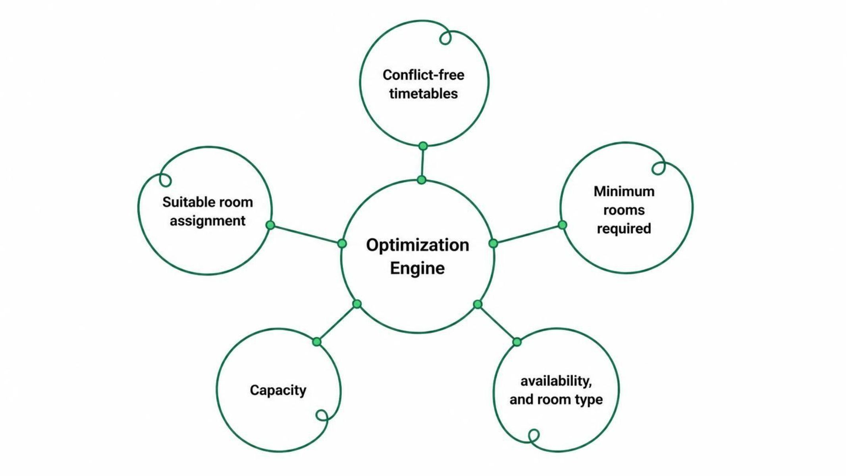
University Timetable Room Minimizer
THE SYSTEM
One optimization engine, fewer conflicts
Generate a timetable and allocate suitable rooms in one coordinated process.
03

Slide 4
University Timetable Room Minimizer
OPTIMIZATION OBJECTIVES
Optimize every room, not just every class
01
02
03
Minimize the number of rooms required
Avoid timetable and room conflicts
Improve classroom utilization
04
05
06
Support laboratories and special rooms
Reduce manual scheduling effort
Generate flexible timetables
04

Slide 5







University Timetable Room Minimizer
Features built for real scheduling teams
Automated generation
Build timetables from scheduling inputs.
Smart allocation
Assign suitable rooms to classes.
Capacity matching
Match rooms to class capacity.
Faculty availability
Respect faculty availability.
Conflict detection
Find timetable and room clashes.
Lab management
Support laboratories and special rooms.
Timetable modification
Make flexible schedule changes.
Utilization monitoring
Review how rooms are used.
Reports
Share timetable and utilization views.
05

Slide 6
University Timetable Room Minimizer
WORKFLOW
From raw data to a final timetable
Stage | Details
Input data | Subjects, faculty, batches, rooms, capacity, time slots, lab requirements.
Constraints | Availability, capacity, room type, and scheduling rules.
Generate | Create timetable possibilities.
Allocate | Assign rooms to classes.
Detect | Check conflicts and clashes.
Optimize | Refine room use and flexibility.
Finalize | Publish the final timetable.
06

Slide 7
University Timetable Room Minimizer
CLASS
DECISION LOGIC
Subject
Constraint satisfaction meets smart allocation
Faculty · batch · lab requirement
Room | Assessment
Room A | Capacity match
Room B | Type mismatch
Room C | Time conflict
Greedy or optimization-based allocation
Conflict detection · capacity matching · utilization analysis
SELECT
Minimum suitable room
MINIMUM-ROOM SELECTION
Capacity, availability, room type, and conflict status align.
07

Slide 8
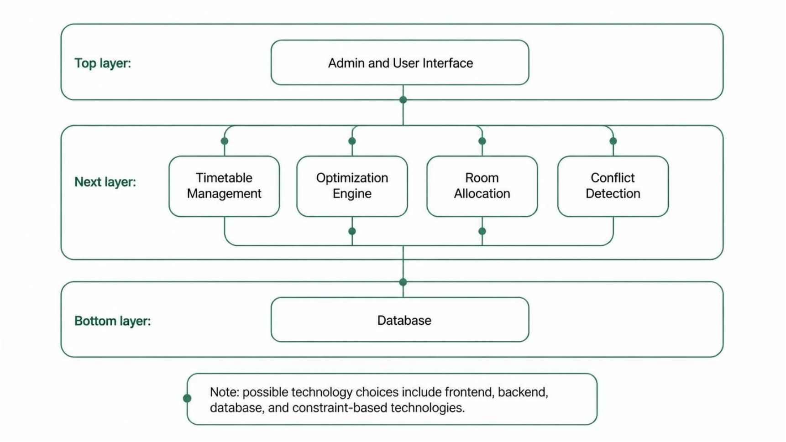
University Timetable Room Minimizer
SYSTEM DESIGN
A modular architecture for campus scheduling
Separate modules keep scheduling inputs, optimization, allocation, and data connected.
08

Slide 9
Advantages And Disadvantages:
Advantages | Disadvantages
📍 Easy and quick location finding | 📡 May depend on GPS/internet connectivity
🧭 Provides efficient route guidance | 🗺️ Requires accurate and updated campus maps
⏱️ Saves time and reduces confusion | 🔄 Regular maintenance and updates are needed
🎓 Helpful for students, staff & visitors | 💻 Initial development cost and effort
🚨 Helps locate emergency facilities | 🔋 Mobile device usage may consume battery
📱 Accessible through web/mobile devices | 🔐 Location data may require privacy protection

Slide 10

University Timetable Room Minimizer
THE VALUE AND THE NEXT STEP
Smart scheduling,
maximum utilization
Automated timetable and room allocation can help universities use limited rooms more effectively.
Future scope
AI/ML optimization · real-time availability · mobile access · attendance integration · dynamic rescheduling · analytics · ERP integration
10

Slide 11
THANK YOU!!

